Slide 1

Week 2
Rosa Maleki

Slide 2
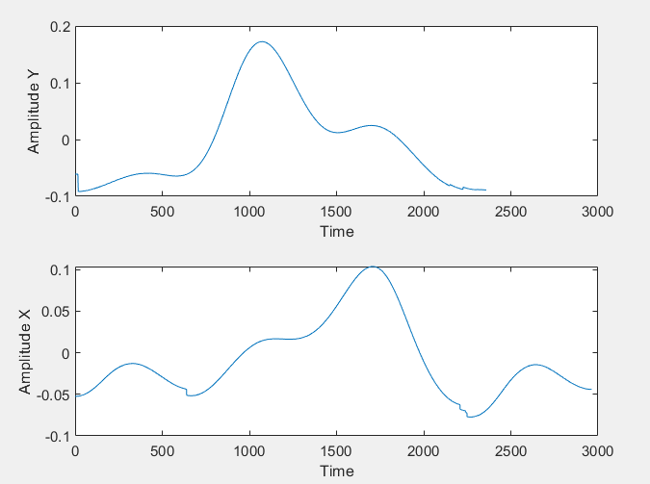
Average the pulse
I tried to average the full pulse by finding their min and aligning their peaks:

Slide 3
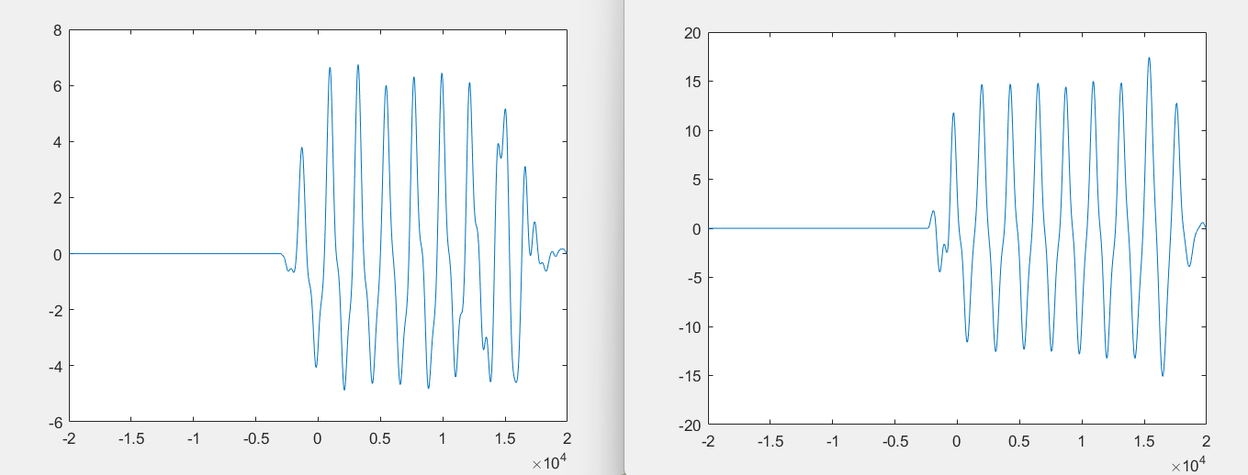
Cross-correlation of the average pulse and the actual pulse
Correlation provides a metric of the linear dependence between two signals.

Slide 4
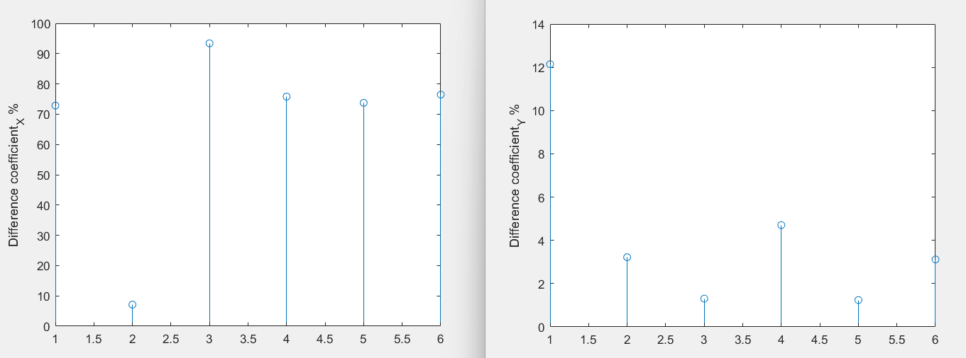

The difference between Average and the Actual signal

Slide 5
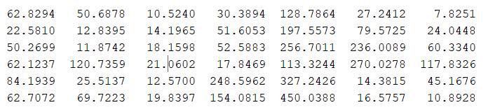
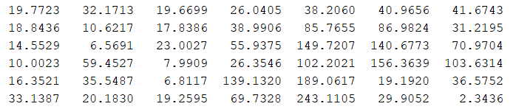
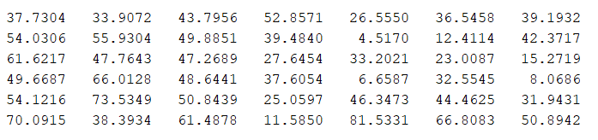
Average pulse with the 4D signal

